Slide 1
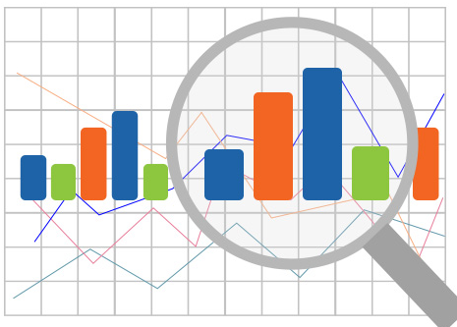
Data Exploration in R
Info@stepupanalytics.com

Slide 2
Data Exploration and Visualization with R
Data Exploration and Visualization
Summary and stats
Various charts like pie charts and histograms
Exploration of multiple variables
Level plot, contour plot and 3D plot
Saving charts into files
Notes:
What is the use of using ? in R?
How to get help for the package in R?
- help(package=“MASS”)
Why the example() command is useful in R?

Slide 3
Size and Structure of Data
dim(iris)
## [1] 150 5
names(iris)
## [1] "Sepal.Length" "Sepal.Width" "Petal.Length" "Petal.Wid...
## [5] "Species"
str(iris)
## 'data.frame': 150 obs. of 5 variables:
## $ Sepal.Length: num 5.1 4.9 4.7 4.6 5 5.4 4.6 5 4.4 4.9 ...
## $ Sepal.Width : num 3.5 3 3.2 3.1 3.6 3.9 3.4 3.4 2.9 3.1...
## $ Petal.Length: num 1.4 1.4 1.3 1.5 1.4 1.7 1.4 1.5 1.4 1...
## $ Petal.Width : num 0.2 0.2 0.2 0.2 0.2 0.4 0.3 0.2 0.2 0...
## $ Species : Factor w/ 3 levels "setosa","versicolor",....

Slide 4
Attributes of Data
attributes(iris)
## $names
## [1] "Sepal.Length" "Sepal.Width" "Petal.Length" "Petal.Wid...
## [5] "Species"
##
## $row.names
## [1] 1 2 3 4 5 6 7 8 9 10 11 12 13 ...
## [16] 16 17 18 19 20 21 22 23 24 25 26 27 28 ...
## [31] 31 32 33 34 35 36 37 38 39 40 41 42 43 ...
## [46] 46 47 48 49 50 51 52 53 54 55 56 57 58 ...
## [61] 61 62 63 64 65 66 67 68 69 70 71 72 73 ...
## [76] 76 77 78 79 80 81 82 83 84 85 86 87 88 ...
## [91] 91 92 93 94 95 96 97 98 99 100 101 102 103 1...
## [106] 106 107 108 109 110 111 112 113 114 115 116 117 118 1...
## [121] 121 122 123 124 125 126 127 128 129 130 131 132 133 1...
## [136] 136 137 138 139 140 141 142 143 144 145 146 147 148 1...
##
## $class
## [1] "data.frame"

Slide 5
First Rows of Data
iris[1:3, ]
## Sepal.Length Sepal.Width Petal.Length Petal.Width Species
## 1 5.1 3.5 1.4 0.2 setosa
## 2 4.9 3.0 1.4 0.2 setosa
## 3 4.7 3.2 1.3 0.2 setosa
head(iris, 3)
## Sepal.Length Sepal.Width Petal.Length Petal.Width Species
## 1 5.1 3.5 1.4 0.2 setosa
## 2 4.9 3.0 1.4 0.2 setosa
## 3 4.7 3.2 1.3 0.2 setosa
tail(iris, 3)
## Sepal.Length Sepal.Width Petal.Length Petal.Width Spe...
## 148 6.5 3.0 5.2 2.0 virgi...
## 149 6.2 3.4 5.4 2.3 virgi...
## 150 5.9 3.0 5.1 1.8 virgi...

Slide 6
A Single Column
The first 10 values of Sepal.Length
iris[1:10, "Sepal.Length"]
## [1] 5.1 4.9 4.7 4.6 5.0 5.4 4.6 5.0 4.4 4.9
iris$Sepal.Length[1:10]
## [1] 5.1 4.9 4.7 4.6 5.0 5.4 4.6 5.0 4.4 4.9

Slide 7
Summary of Data
Function summary()
numeric variables: minimum, maximum, mean, median, and the first (25%) and third (75%) quartiles
categorical variables (factors): frequency of every level
summary(iris)
## Sepal.Length Sepal.Width Petal.Length Petal.Wid...
## Min. :4.300 Min. :2.000 Min. :1.000 Min. :0....
## 1st Qu.:5.100 1st Qu.:2.800 1st Qu.:1.600 1st Qu.:0....
## Median :5.800 Median :3.000 Median :4.350 Median :1....
## Mean :5.843 Mean :3.057 Mean :3.758 Mean :1....
## 3rd Qu.:6.400 3rd Qu.:3.300 3rd Qu.:5.100 3rd Qu.:1....
## Max. :7.900 Max. :4.400 Max. :6.900 Max. :2....
## Species
## setosa :50
## versicolor:50
## virginica :50

Slide 8
Mean, Median, Range and Quartiles
Mean, median and range: mean(), median(), range()
Quartiles and percentiles: quantile()
range(iris$Sepal.Length)
## [1] 4.3 7.9
quantile(iris$Sepal.Length)
## 0% 25% 50% 75% 100%
## 4.3 5.1 5.8 6.4 7.9
quantile(iris$Sepal.Length, c(0.1, 0.3, 0.65))
## 10% 30% 65%
## 4.80 5.27 6.20

Slide 9
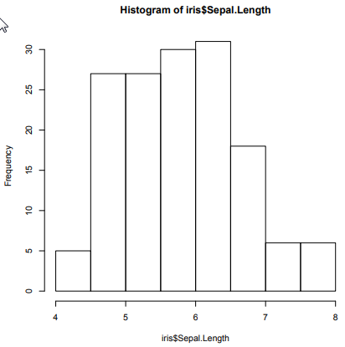
Variance and Histogram
var(iris$Sepal.Length)
## [1] 0.6856935
hist(iris$Sepal.Length)

Slide 10
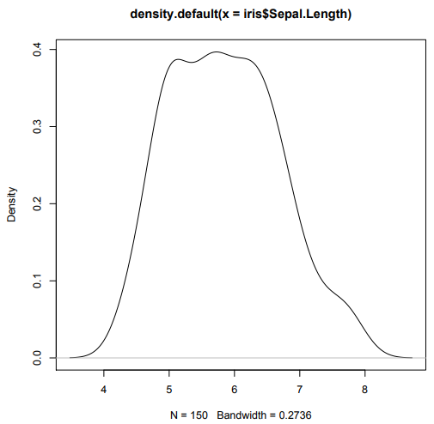
Density
plot(density(iris$Sepal.Length))

Slide 11
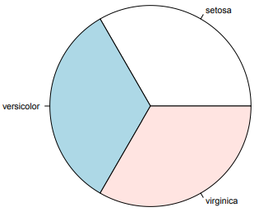
Pie Chart
Frequency of factors: table()
table(iris$Species)
##
## setosa versicolor virginica
## 50 50 50
pie(table(iris$Species))

Slide 12
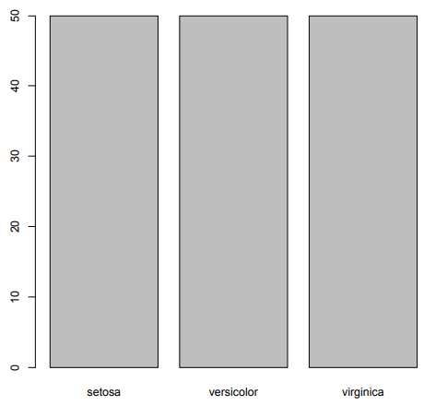
Bar Chart
barplot(table(iris$Species))

Slide 13


